Slide 1










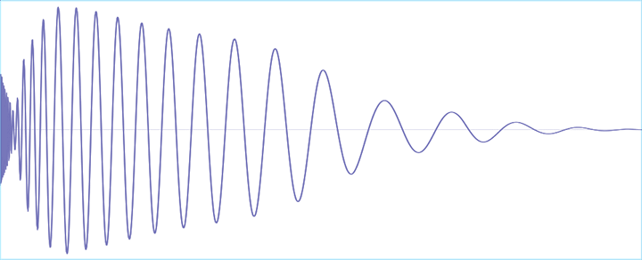

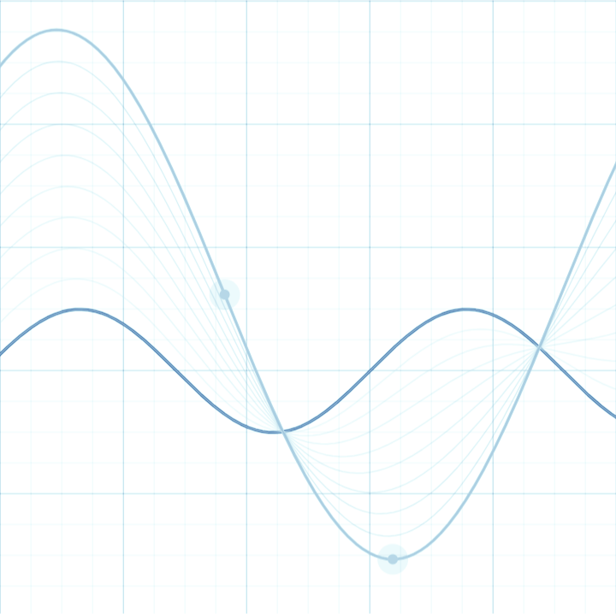

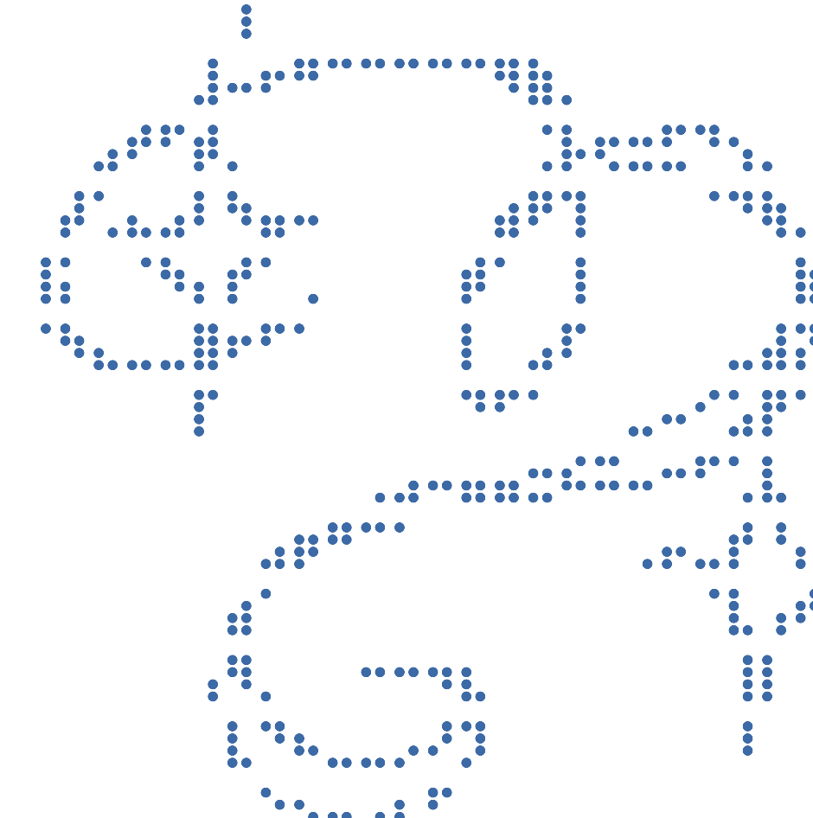

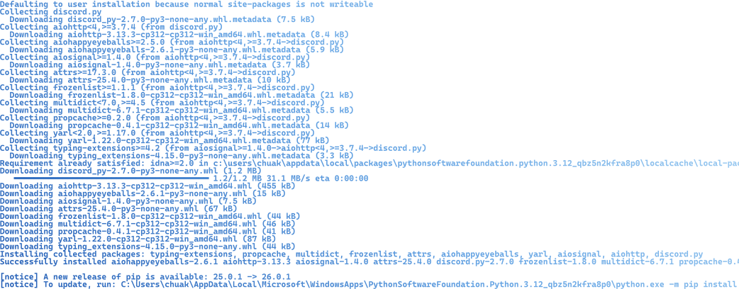


BATTERY 010% CPU 006% AMD RYZEN 9 7845HX GPU 001% 4.8GB NVDIA RTX 4060 LAPTOP RAM 13.1GB DDR5 GSTRIX
⋆⭒˚.⋆
~
*
⋆⭒˚.⋆
Data Representation
*
100%
COPYRIGHT BIT BY BIT CODING © 2026. ALL RIGHTS RESERVED. ANY RESEMBLANCE TO ACTUAL PEOPLE, EVENTS, OR LOCALES IS PURE COINCIDENCE.
18°18'00.6"N 64°49'30.5"W ISO 1600 f5.6 1/2000s 2026/03/01 21:07:30 HOURS UNIX 1772370534 VERSION 1.0 OS WINDOWS

Slide 2
BATTERY 010% CPU 006% AMD RYZEN 9 7845HX GPU 001% 4.8GB NVDIA RTX 4060 LAPTOP RAM 13.1GB DDR5 GSTRIX
But first… a magic trick
1 | 3 | 5 | 7 | 9 | 11 | 13
15 | 17 | 19 | 21 | 23 | 25 | 27
29 | 31 | 33 | 35 | 37 | 39 | 41
43 | 45 | 47 | 49 | 51 | 53 | 55
57 | 59 | 61 | 63 | 65 | 67 | 69
71 | 73 | 75 | 77 | 79 | 81 | 83
85 | 87 | 89 | 91 | 93 | 95 | 97
99
2 | 3 | 6 | 7 | 10 | 11 | 14
15 | 18 | 19 | 22 | 23 | 26 | 27
30 | 31 | 34 | 35 | 38 | 39 | 42
43 | 46 | 47 | 50 | 51 | 54 | 55
58 | 59 | 62 | 63 | 66 | 67 | 70
71 | 74 | 75 | 78 | 79 | 82 | 83
86 | 87 | 90 | 91 | 94 | 95 | 98
99
4 | 5 | 6 | 7 | 12 | 13 | 14
15 | 20 | 21 | 22 | 23 | 28 | 29
30 | 31 | 36 | 37 | 38 | 39 | 44
45 | 46 | 47 | 52 | 53 | 54 | 55
60 | 61 | 62 | 63 | 68 | 69 | 70
71 | 76 | 77 | 78 | 79 | 84 | 85
86 | 87 | 92 | 93 | 94 | 95
8 | 9 | 10 | 11 | 12 | 13 | 14
15 | 24 | 25 | 26 | 27 | 28 | 29
30 | 31 | 40 | 41 | 42 | 43 | 44
45 | 46 | 47 | 56 | 57 | 58 | 59
60 | 61 | 62 | 63 | 68 | 69 | 70
71 | 76 | 77 | 78 | 79 | 84 | 85
86 | 87 | 92 | 93 | 94 | 95
⋆⭒˚.⋆
⋆⭒˚.⋆
16 | 17 | 18 | 19 | 20 | 21 | 22
23 | 24 | 25 | 26 | 27 | 28 | 29
30 | 31 | 48 | 49 | 50 | 51 | 52
53 | 54 | 55 | 56 | 57 | 58 | 59
60 | 61 | 62 | 63 | 80 | 81 | 82
83 | 84 | 85 | 86 | 87 | 88 | 89
90 | 91 | 92 | 93 | 94 | 95
Which cards do you see your number in?
32 | 33 | 34 | 35 | 36 | 37 | 38
39 | 40 | 41 | 42 | 43 | 44 | 45
46 | 47 | 48 | 49 | 50 | 51 | 52
53 | 54 | 55 | 56 | 57 | 58 | 59
60 | 61 | 62 | 63 | 96 | 97 | 98
99
64 | 65 | 66 | 67 | 68 | 69 | 70
71 | 72 | 73 | 74 | 75 | 76 | 77
78 | 79 | 80 | 81 | 82 | 83 | 84
85 | 86 | 87 | 88 | 89 | 90 | 91
92 | 93 | 94 | 95 | 96 | 97 | 98
99
100%
COPYRIGHT BIT BY BIT CODING © 2026. ALL RIGHTS RESERVED. ANY RESEMBLANCE TO ACTUAL PEOPLE, EVENTS, OR LOCALES IS PURE COINCIDENCE.
18°18'00.6"N 64°49'30.5"W ISO 1600 f5.6 1/2000s 2026/03/01 21:07:30 HOURS UNIX 1772370534 VERSION 1.0 OS WINDOWS

Slide 3
BATTERY 010% CPU 006% AMD RYZEN 9 7845HX GPU 001% 4.8GB NVDIA RTX 4060 LAPTOP RAM 13.1GB DDR5 GSTRIX
What is binary?
>
Binary is how computers store data
It’s only made up of ones and zeros
18°18'00.6"N 64°49'30.5"W ISO 1600 f5.6 1/2000s 2026/03/01 21:07:30 HOURS UNIX 1772370534 VERSION 1.0 OS WINDOWS
>
100%
⋆⭒˚.⋆

Slide 4



BATTERY 010% CPU 006% AMD RYZEN 9 7845HX GPU 001% 4.8GB NVDIA RTX 4060 LAPTOP RAM 13.1GB DDR5 GSTRIX
Binary to decimal
>
Take our normal counting system (a.k.a decimal) for example
18°18'00.6"N 64°49'30.5"W ISO 1600 f5.6 1/2000s 2026/03/01 21:07:30 HOURS UNIX 1772370534 VERSION 1.0 OS WINDOWS
167
100%
⋆⭒˚.⋆

Slide 5






BATTERY 010% CPU 006% AMD RYZEN 9 7845HX GPU 001% 4.8GB NVDIA RTX 4060 LAPTOP RAM 13.1GB DDR5 GSTRIX
Binary to decimal
>
Binary instead uses powers of 2
Read from right to left, with each power increasing by 1 for every digit
>
18°18'00.6"N 64°49'30.5"W ISO 1600 f5.6 1/2000s 2026/03/01 21:07:30 HOURS UNIX 1772370534 VERSION 1.0 OS WINDOWS
1010
100%
⋆⭒˚.⋆

Slide 6
BATTERY 010% CPU 006% AMD RYZEN 9 7845HX GPU 001% 4.8GB NVDIA RTX 4060 LAPTOP RAM 13.1GB DDR5 GSTRIX
Binary to decimal
18°18'00.6"N 64°49'30.5"W ISO 1600 f5.6 1/2000s 2026/03/01 21:07:30 HOURS UNIX 1772370534 VERSION 1.0 OS WINDOWS
111010
⋆⭒˚.⋆

Slide 7
BATTERY 010% CPU 006% AMD RYZEN 9 7845HX GPU 001% 4.8GB NVDIA RTX 4060 LAPTOP RAM 13.1GB DDR5 GSTRIX
Let’s try!
⋆⭒˚.⋆
0001 | 0011 | 0101 | 1000
1 | 3 | 5 | 8
1110 | 1101 | 1100 | 0100
14 | 13 | 12 | 4
1001 | 0000 | 0111 | 0010
9 | 0 | 7 | 2
1011 | 0110 | 1010 | 1111
11 | 6 | 10 | 15
~
⋆⭒˚.⋆
100%
COPYRIGHT BIT BY BIT CODING © 2026. ALL RIGHTS RESERVED. ANY RESEMBLANCE TO ACTUAL PEOPLE, EVENTS, OR LOCALES IS PURE COINCIDENCE.
18°18'00.6"N 64°49'30.5"W ISO 1600 f5.6 1/2000s 2026/03/01 21:07:30 HOURS UNIX 1772370534 VERSION 1.0 OS WINDOWS

Slide 8
BATTERY 010% CPU 006% AMD RYZEN 9 7845HX GPU 001% 4.8GB NVDIA RTX 4060 LAPTOP RAM 13.1GB DDR5 GSTRIX
The secret behind the trick
1 | 3 | 5 | 7 | 9 | 11 | 13
15 | 17 | 19 | 21 | 23 | 25 | 27
29 | 31 | 33 | 35 | 37 | 39 | 41
43 | 45 | 47 | 49 | 51 | 53 | 55
57 | 59 | 61 | 63 | 65 | 67 | 69
71 | 73 | 75 | 77 | 79 | 81 | 83
85 | 87 | 89 | 91 | 93 | 95 | 97
99
2 | 3 | 6 | 7 | 10 | 11 | 14
15 | 18 | 19 | 22 | 23 | 26 | 27
30 | 31 | 34 | 35 | 38 | 39 | 42
43 | 46 | 47 | 50 | 51 | 54 | 55
58 | 59 | 62 | 63 | 66 | 67 | 70
71 | 74 | 75 | 78 | 79 | 82 | 83
86 | 87 | 90 | 91 | 94 | 95 | 98
99
4 | 5 | 6 | 7 | 12 | 13 | 14
15 | 20 | 21 | 22 | 23 | 28 | 29
30 | 31 | 36 | 37 | 38 | 39 | 44
45 | 46 | 47 | 52 | 53 | 54 | 55
60 | 61 | 62 | 63 | 68 | 69 | 70
71 | 76 | 77 | 78 | 79 | 84 | 85
86 | 87 | 92 | 93 | 94 | 95
8 | 9 | 10 | 11 | 12 | 13 | 14
15 | 24 | 25 | 26 | 27 | 28 | 29
30 | 31 | 40 | 41 | 42 | 43 | 44
45 | 46 | 47 | 56 | 57 | 58 | 59
60 | 61 | 62 | 63 | 68 | 69 | 70
71 | 76 | 77 | 78 | 79 | 84 | 85
86 | 87 | 92 | 93 | 94 | 95
⋆⭒˚.⋆
⋆⭒˚.⋆
Each card is a binary number!
Let’s try 67 🤣😭🙏
16 | 17 | 18 | 19 | 20 | 21 | 22
23 | 24 | 25 | 26 | 27 | 28 | 29
30 | 31 | 48 | 49 | 50 | 51 | 52
53 | 54 | 55 | 56 | 57 | 58 | 59
60 | 61 | 62 | 63 | 80 | 81 | 82
83 | 84 | 85 | 86 | 87 | 88 | 89
90 | 91 | 92 | 93 | 94 | 95
32 | 33 | 34 | 35 | 36 | 37 | 38
39 | 40 | 41 | 42 | 43 | 44 | 45
46 | 47 | 48 | 49 | 50 | 51 | 52
53 | 54 | 55 | 56 | 57 | 58 | 59
60 | 61 | 62 | 63 | 96 | 97 | 98
99
64 | 65 | 66 | 67 | 68 | 69 | 70
71 | 72 | 73 | 74 | 75 | 76 | 77
78 | 79 | 80 | 81 | 82 | 83 | 84
85 | 86 | 87 | 88 | 89 | 90 | 91
92 | 93 | 94 | 95 | 96 | 97 | 98
99
100%
COPYRIGHT BIT BY BIT CODING © 2026. ALL RIGHTS RESERVED. ANY RESEMBLANCE TO ACTUAL PEOPLE, EVENTS, OR LOCALES IS PURE COINCIDENCE.
18°18'00.6"N 64°49'30.5"W ISO 1600 f5.6 1/2000s 2026/03/01 21:07:30 HOURS UNIX 1772370534 VERSION 1.0 OS WINDOWS

Slide 9
BATTERY 010% CPU 006% AMD RYZEN 9 7845HX GPU 001% 4.8GB NVDIA RTX 4060 LAPTOP RAM 13.1GB DDR5 GSTRIX
The secret behind the trick
1 | 3 | 5 | 7 | 9 | 11 | 13
15 | 17 | 19 | 21 | 23 | 25 | 27
29 | 31 | 33 | 35 | 37 | 39 | 41
43 | 45 | 47 | 49 | 51 | 53 | 55
57 | 59 | 61 | 63 | 65 | 67 | 69
71 | 73 | 75 | 77 | 79 | 81 | 83
85 | 87 | 89 | 91 | 93 | 95 | 97
99
1 | 3 | 5 | 7 | 9 | 11 | 13
15 | 17 | 19 | 21 | 23 | 25 | 27
29 | 31 | 33 | 35 | 37 | 39 | 41
43 | 45 | 47 | 49 | 51 | 53 | 55
57 | 59 | 61 | 63 | 65 | 67 | 69
71 | 73 | 75 | 77 | 79 | 81 | 83
85 | 87 | 89 | 91 | 93 | 95 | 97
99
2 | 3 | 6 | 7 | 10 | 11 | 14
15 | 18 | 19 | 22 | 23 | 26 | 27
30 | 31 | 34 | 35 | 38 | 39 | 42
43 | 46 | 47 | 50 | 51 | 54 | 55
58 | 59 | 62 | 63 | 66 | 67 | 70
71 | 74 | 75 | 78 | 79 | 82 | 83
86 | 87 | 90 | 91 | 94 | 95 | 98
99
2 | 3 | 6 | 7 | 10 | 11 | 14
15 | 18 | 19 | 22 | 23 | 26 | 27
30 | 31 | 34 | 35 | 38 | 39 | 42
43 | 46 | 47 | 50 | 51 | 54 | 55
58 | 59 | 62 | 63 | 66 | 67 | 70
71 | 74 | 75 | 78 | 79 | 82 | 83
86 | 87 | 90 | 91 | 94 | 95 | 98
99
4 | 5 | 6 | 7 | 12 | 13 | 14
15 | 20 | 21 | 22 | 23 | 28 | 29
30 | 31 | 36 | 37 | 38 | 39 | 44
45 | 46 | 47 | 52 | 53 | 54 | 55
60 | 61 | 62 | 63 | 68 | 69 | 70
71 | 76 | 77 | 78 | 79 | 84 | 85
86 | 87 | 92 | 93 | 94 | 95
8 | 9 | 10 | 11 | 12 | 13 | 14
15 | 24 | 25 | 26 | 27 | 28 | 29
30 | 31 | 40 | 41 | 42 | 43 | 44
45 | 46 | 47 | 56 | 57 | 58 | 59
60 | 61 | 62 | 63 | 68 | 69 | 70
71 | 76 | 77 | 78 | 79 | 84 | 85
86 | 87 | 92 | 93 | 94 | 95
⋆⭒˚.⋆
⋆⭒˚.⋆
1000011
16 | 17 | 18 | 19 | 20 | 21 | 22
23 | 24 | 25 | 26 | 27 | 28 | 29
30 | 31 | 48 | 49 | 50 | 51 | 52
53 | 54 | 55 | 56 | 57 | 58 | 59
60 | 61 | 62 | 63 | 80 | 81 | 82
83 | 84 | 85 | 86 | 87 | 88 | 89
90 | 91 | 92 | 93 | 94 | 95
64 | 65 | 66 | 67 | 68 | 69 | 70
71 | 72 | 73 | 74 | 75 | 76 | 77
78 | 79 | 80 | 81 | 82 | 83 | 84
85 | 86 | 87 | 88 | 89 | 90 | 91
92 | 93 | 94 | 95 | 96 | 97 | 98
99
32 | 33 | 34 | 35 | 36 | 37 | 38
39 | 40 | 41 | 42 | 43 | 44 | 45
46 | 47 | 48 | 49 | 50 | 51 | 52
53 | 54 | 55 | 56 | 57 | 58 | 59
60 | 61 | 62 | 63 | 96 | 97 | 98
99
64 | 65 | 66 | 67 | 68 | 69 | 70
71 | 72 | 73 | 74 | 75 | 76 | 77
78 | 79 | 80 | 81 | 82 | 83 | 84
85 | 86 | 87 | 88 | 89 | 90 | 91
92 | 93 | 94 | 95 | 96 | 97 | 98
99
100%
COPYRIGHT BIT BY BIT CODING © 2026. ALL RIGHTS RESERVED. ANY RESEMBLANCE TO ACTUAL PEOPLE, EVENTS, OR LOCALES IS PURE COINCIDENCE.
18°18'00.6"N 64°49'30.5"W ISO 1600 f5.6 1/2000s 2026/03/01 21:07:30 HOURS UNIX 1772370534 VERSION 1.0 OS WINDOWS

Slide 10
BATTERY 010% CPU 006% AMD RYZEN 9 7845HX GPU 001% 4.8GB NVDIA RTX 4060 LAPTOP RAM 13.1GB DDR5 GSTRIX
Decimal to binary
>
Divide by 2
Write down the remainder on one side
Continue dividing the result until the number is zero
Reverse the remainders
>
>
18°18'00.6"N 64°49'30.5"W ISO 1600 f5.6 1/2000s 2026/03/01 21:07:30 HOURS UNIX 1772370534 VERSION 1.0 OS WINDOWS
>
Decimal | Quotient | Remainder
135 | 135/2 = 67 | 1
67 | 67/2 = 33 | 1
33 | 33/2 = 16 | 1
16 | 16/2 = 8 | 0
8 | 8/2 = 4 | 0
4 | 4/2 = 2 | 0
2 | 2/2 = 1 | 0
1 | 1/2 = 0 | 1
>
135 = 10000111
100%
⋆⭒˚.⋆

Slide 11
BATTERY 010% CPU 006% AMD RYZEN 9 7845HX GPU 001% 4.8GB NVDIA RTX 4060 LAPTOP RAM 13.1GB DDR5 GSTRIX
Hexadecimal
>
Hexadecimal uses bases of 16 instead of 2 or 10
Used in hex codes and MAC addresses
>
18°18'00.6"N 64°49'30.5"W ISO 1600 f5.6 1/2000s 2026/03/01 21:07:30 HOURS UNIX 1772370534 VERSION 1.0 OS WINDOWS
0 | 1 | 2 | 3 | 4 | 5 | 6 | 7 | 8 | 9 | 10 | 11 | 12 | 13 | 14 | 15
0 | 1 | 2 | 3 | 4 | 5 | 6 | 7 | 8 | 9 | A | B | C | D | E | F
#FF0000 | #00FF00 | #0000FF | #FFFFFF | #000000
#FFEECC
100%
Red
Green
Blue
⋆⭒˚.⋆

Slide 12




BATTERY 010% CPU 006% AMD RYZEN 9 7845HX GPU 001% 4.8GB NVDIA RTX 4060 LAPTOP RAM 13.1GB DDR5 GSTRIX
Hexadecimal to decimal
>
Start from right to left, with each power of 16 increasing by 1 for every digit
18°18'00.6"N 64°49'30.5"W ISO 1600 f5.6 1/2000s 2026/03/01 21:07:30 HOURS UNIX 1772370534 VERSION 1.0 OS WINDOWS
0 | 1 | 2 | 3 | 4 | 5 | 6 | 7 | 8 | 9 | 10 | 11 | 12 | 13 | 14 | 15
0 | 1 | 2 | 3 | 4 | 5 | 6 | 7 | 8 | 9 | A | B | C | D | E | F
CF16
100%
⋆⭒˚.⋆

Slide 13
BATTERY 010% CPU 006% AMD RYZEN 9 7845HX GPU 001% 4.8GB NVDIA RTX 4060 LAPTOP RAM 13.1GB DDR5 GSTRIX
Hexadecimal to decimal
>
Start from right to left, with each power of 16 increasing by 1 for every digit
18°18'00.6"N 64°49'30.5"W ISO 1600 f5.6 1/2000s 2026/03/01 21:07:30 HOURS UNIX 1772370534 VERSION 1.0 OS WINDOWS
0 | 1 | 2 | 3 | 4 | 5 | 6 | 7 | 8 | 9 | 10 | 11 | 12 | 13 | 14 | 15
0 | 1 | 2 | 3 | 4 | 5 | 6 | 7 | 8 | 9 | A | B | C | D | E | F
CF16
⋆⭒˚.⋆

Slide 14
BATTERY 010% CPU 006% AMD RYZEN 9 7845HX GPU 001% 4.8GB NVDIA RTX 4060 LAPTOP RAM 13.1GB DDR5 GSTRIX
Decimal to hexadecimal
>
Divide by 2
Write down the remainder on one side and the hexadecimal equivalent
Continue dividing the result until the number is zero
Reverse the remainders
>
18°18'00.6"N 64°49'30.5"W ISO 1600 f5.6 1/2000s 2026/03/01 21:07:30 HOURS UNIX 1772370534 VERSION 1.0 OS WINDOWS
>
>
>
>
2663= A67
Decimal | Quotient | Remainder
2663 | 2663/16 = 166 | 7=7
166 | 166/16 = 10 | 6=6
10 | 16/16=0 | 10=A
100%
⋆⭒˚.⋆

Slide 15
BATTERY 010% CPU 006% AMD RYZEN 9 7845HX GPU 001% 4.8GB NVDIA RTX 4060 LAPTOP RAM 13.1GB DDR5 GSTRIX
Hexadecimal to binary
>
Convert each hexadecimal number to its binary equivalent and join it together
18°18'00.6"N 64°49'30.5"W ISO 1600 f5.6 1/2000s 2026/03/01 21:07:30 HOURS UNIX 1772370534 VERSION 1.0 OS WINDOWS
0 | 1 | 2 | 3 | 4 | 5 | 6 | 7
0000 | 0001 | 0010 | 0011 | 0100 | 0101 | 0110 | 0111
8 | 9 | A | B | C | D | E | F
1000 | 1001 | 1010 | 1011 | 1100 | 1101 | 1110 | 1111
CF16
1100
1111
0001
0101
100%
1100111100010101
⋆⭒˚.⋆

Slide 16

BbB Term 1 Feedback
Please help us complete this form!
We will issue certificates through the email provided in this form.
Link: tinyurl.com/bbb-term1-feedback

Slide 17

Sign ups for term 2 are open!
If you know friends who’d benefit from this programme, do send them the link!
Link: tinyurl.com/bbb-term2-register
[Intermediate -> Advanced in term 3 (Nov)]

Slide 18
BATTERY 010% CPU 006% AMD RYZEN 9 7845HX GPU 001% 4.8GB NVDIA RTX 4060 LAPTOP RAM 13.1GB DDR5 GSTRIX
⋆⭒˚.⋆
~
*
⋆⭒˚.⋆
Thank you!
*
100%
COPYRIGHT BIT BY BIT CODING © 2026. ALL RIGHTS RESERVED. ANY RESEMBLANCE TO ACTUAL PEOPLE, EVENTS, OR LOCALES IS PURE COINCIDENCE.
18°18'00.6"N 64°49'30.5"W ISO 1600 f5.6 1/2000s 2026/03/01 21:07:30 HOURS UNIX 1772370534 VERSION 1.0 OS WINDOWS

